Slide 2
Rock the DECA Role Play and Exam
Understanding what goes into the DECA Role Play and Exam

Slide 3
DECA EXAMS

Slide 4
DECA EXAMS

Slide 5
THE BASICS
100 questions
Multiple choice
True/False and combination items are generally not used.
Blueprints are provided.
By instructional area.
By content at each level of competition
Testing is objective – it’s up to DECA members
In team events, test scores are averaged

Slide 6
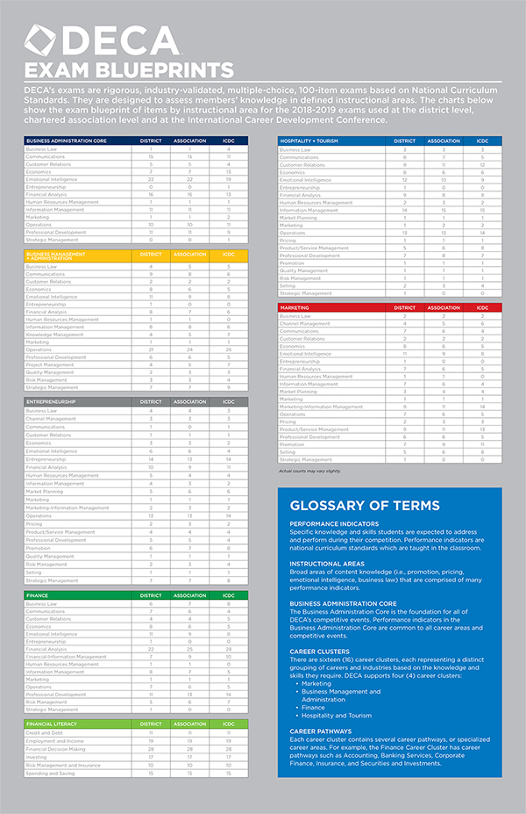
EXAM BLUEPRINTS

Slide 8
PERFORMANCE INDICATOR LISTS

Slide 9
IMPORTANT TERMS
Instructional Areas
Broad areas of content knowledge (i.e., promotion, pricing, emotional intelligence, business law) that are comprised of many performance indicators.
Performance Indicators
Specific knowledge and skills students are expected to address and perform during their competition.

Slide 10
PRINCIPLES OF BUSINESS ADMINISTRATION EVENTS
BUSINESS ADMINISTRATION CORE Business Law Communication Skills Customer Relations Economics Emotional Intelligence Financial Analysis Human Resources Management Information Management Marketing Operations Professional Development Strategic Management

Slide 11
TEAM DECISION MAKING EVENTS INDIVIDUAL SERIES EVENTS INTEGRATED MARKETING CAMPAIGN EVENTS PROFESSIONAL SELLING AND CONSULTING EVENTS
Except Entrepreneurship Individual Series and Entrepreneurship Team Decision Making
MARKETING CLUSTER | BUSINESS MANAGEMENT + ADMINISTRATION CLUSTER | FINANCE CLUSTER | HOSPITALITY + TOURISM CLUSTER
INSTRUCTIONAL AREAS Channel Management Marketing-Information Management Market Planning Pricing Promotion Product/Service Management Selling | INSTRUCTIONAL AREAS Knowledge Management Project Management Quality Management Risk Management | INSTRUCTIONAL AREAS Compliance Financial-Information Management Product/Service Management Risk Management | INSTRUCTIONAL AREAS Market Planning Pricing Product/Service Management Promotion Quality Management Risk Management Selling
BUSINESS ADMINISTRATION CORE

Slide 12
ENTREPRENEURSHIP INDIVIDUAL SERIES EVENT ENTREPRENEURSHIP TEAM DECISION MAKING EVENT
Relevant from the Business Administration Core and each Career Cluster
MARKETING CLUSTER | BUSINESS MANAGEMENT + ADMINISTRATION CLUSTER | FINANCE CLUSTER
BUSINESS ADMINISTRATION CORE

Slide 13
PERSONAL FINANICAL LITERACY EVENT
NATIONAL STANDARDS IN K-12 PERSONAL FINANCE EDUCATION Spending and Saving Credit and Debt Employment and Income Investing Risk and Insurance Financial Decision Making

Slide 14
PERFORMANCE INDICATOR LISTS

Slide 15
COMPETITIVE EVENTS FRAMEWORK
Four levels of specialization within each cluster.
Six curriculum planning levels within each tier.

Slide 16
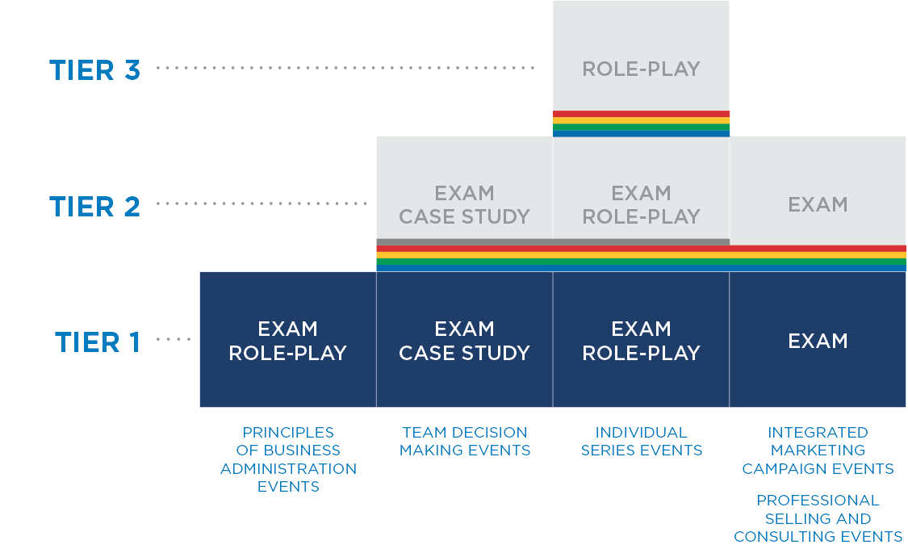
FOR THE EXAM:
STOP AT TIER 1
STOP AT TIER 2
STOP AT TIER 2
STOP AT TIER 2

Slide 17
PERFORMANCE INDICATORS
Tier 1: Business Administration Core
Tier 2: Cluster
Tier 3: Pathway

Slide 19
CURRICULUM PLANNING LEVELS
Prerequisite (PQ)
Career Sustaining (CS)
Specialist (SP)
Supervisor (SU)
Manager (MN)
Owner (ON)

Slide 21
PERCENTAGES
As members advance in competition, content becomes more specialized to the Career Cluster
 | DISTRICT | ASSOCIATION | ICDC
Business Administration Core | 60 | 50 | 40
Career Cluster | 40 | 50 | 60

Slide 22
Written communication is not effective when readers must
A. find the information they need within the communication.
B. follow the writer's logical train of thought.
C. work to understand what the communication means.
D. spend a minimum amount of time reading the communication.

Slide 23
C. Work to understand what the communication means.
Instructional Area: Communications
Performance Indicator: Explain the nature of effective written communications (CO:016) (CS)

Slide 24
GENERAL TEST TAKING STRATEGIES
Familiarize yourself with the format.
Read the question. Think about the answer.
Read all choices before choosing your answer.
Eliminate choices you know aren’t correct.
If you get stuck, circle and come back.
Always take an educated guess.
If time allows, review your work.

Slide 25
What’s In A Role Play!

Slide 26
What To
Expect

Slide 27
What to Expect
Only the PRIMARY Instructional Area – Multiple IAs are often used

Slide 28
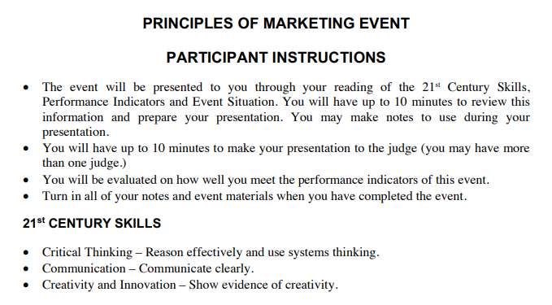
What to Expect
Same EVERY Time
- Don’t waste time reading this each Role Play

Slide 29
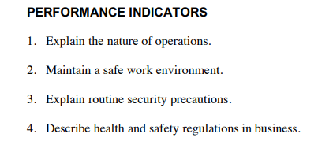
What to Expect
MOST IMPORTANT INFORMATION ON PAGE 1

Slide 30
What to Expect

Slide 31
Prep Time

Slide 32
Prep Time
Principles Events: 10 Minutes of Prep Time + 10 Minutes of Interview Time
Team Decision Events: 30 Minutes of Prep Time + 15 Minutes of Interview Time
Individual Series Events: 10 Minutes of Prep Time + 10 Minutes of Interview Time
Personal Finance Literacy Event: 10 Minutes of Prep Time + 10 Minutes of Interview Time

Slide 33
Prep Time
Write all performance indicators on your page so you don’t forget them
Write important details of your role play
Create diagrams or charts over your topic
Fold your paper into parts and create a slide style presentation
Write down acronyms
Create a flyer through design on your plain piece of paper

Slide 34
Breaking Down Your Prep Time (recommendations)
10 Minutes to Prep
1-2 Minutes – Read and write down key words in performance indicators and scenario
4 Minutes – Map out main ideas, check off performance indicators
1 Minute – Re-read the scenario confirming your main ideas and performance indicators align
3-4 Minutes – Walk through presentation skeleton
30 Minutes to Prep
2-3 Minutes – Read performance indicators and scenario individually.
2-3 Minutes – Go through the performance indicator list to divide tasks
5 Minutes – Brainstorm ideas/solutions
8 Minutes – Map out main ideas, check off performance indicators
1-2 Minutes – Re-read scenario confirming your main ideas and performance indicators align
7 Minutes – Walkthrough presentation skeleton
2 Minutes – Ask each other 1 question about their part

Slide 35
Materials

Slide 36
Materials
Plain Piece of Paper Front and Back
1 Pencil with Eraser
Role Play Sheet with Instructions & Performance Indicators
Role Play Sheet explaining Case Study or Interview Topic

Slide 37
Interview Time

Slide 38
Interview Time
Introduce yourself to the judge as your title written in the role play
Give a firm handshake and pleasant smile
Talk to them about how you and your department have been working on figuring out this issue
Show them your flyer/slide style presentation/diagrams/charts
Discuss “previous” projects
Try to make some jokes or talk about personal experiences
Bring in real world examples to discuss
End the interview with a firm handshake and tell them your secretary can fax over the notes

Slide 39
Tips

Slide 40
Tips
Figure out performance indicators for your event ahead of time so you have studied them and know what to say for each
Look up common marketing and sales facts that you can say to impress your judge
Stay in character the whole time
You set the stage. You can add details and information not listed in the role play, but be sure not to contradict the scenario.
You can find sample role play videos showing how the process goes on deca.org

Slide 41
RESOURCES

